Slide 1
Disambiguation of English Puns
I. Vijayasaradhi

Slide 2
Definition
Pun (paranomasia) : A form of word play that exploits multiple meanings of a word.
Types of puns - Homographic(same spelling), Homophonic(same sound, spelling may be different), Heterographic, Heterophonic.

Slide 3
Examples
I used to be a banker, I lost interest.
A cowboy who was also an artist could draw fast.
A lumberjack’s world revolves on its axes.
She fell through the window but felt no pane.
“I want a scooter,” Tom moped

Slide 4
Why to detect puns
Commonly used in advertising usually for humour.
Immense potential for machine translation.
Used for generating humour in Human Computer Interaction.
Can be used to detect humour.

Slide 5
Characteristics of puns
The two senses of the pun word may have different parts of speech (and sometimes the sentence may be grammatically incorrect with a sense).
More likely to exploit coarse-grained homonymy(same pronunciation, different meaning) than fine-grained systematic polysemy(same word, different meaning)

Slide 6
Observations from a dataset
POS distribution: 50.2% Noun, 33.8% Verb, 13.1% Adjective, 1.3% Mixed POS
Location: Q1 1.2%, Q2 6.7%, Q3 9.3%, Q4 82.8%. The punchword occurs at the end !
Sufficient context for the other sense given in the first half of the pun.

Slide 7
Word Sense Disambiguation
Traditional WSD requires to assign only 1 sense to a target word.
Pun disambiguation requires to assign multiple(usually 2) senses to a target word.

Slide 8
Traditional WSD algorithms
Simplified Lesk (Kilgarriff and Rosenzweig, 2000)
Simplified Extended Lesk (Ponzetto and Navigli, 2010)
Simplified lexically expanded Lesk (Miller et al., 2012)

Slide 9
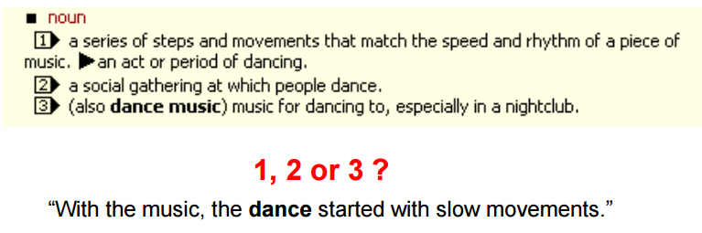
Simplified Lesk
Measure the overlap between the (sentence) context of the target, and the definition of its senses If no overlap, use most frequent sense (MFS)

Slide 10
Simplified Extended Lesk
Similar to simplified Lesk, except that the definition for each sense is concatenated with those of neighbouring senses in Word-Net’s semantic network.

Slide 11
Simplified Lexically expanded Lesk
Is based on simplified Lesk, with the extension that every word in the context and sense difinitions is expanded with up to 100 entries from a large distributional thesaurus.

Slide 12
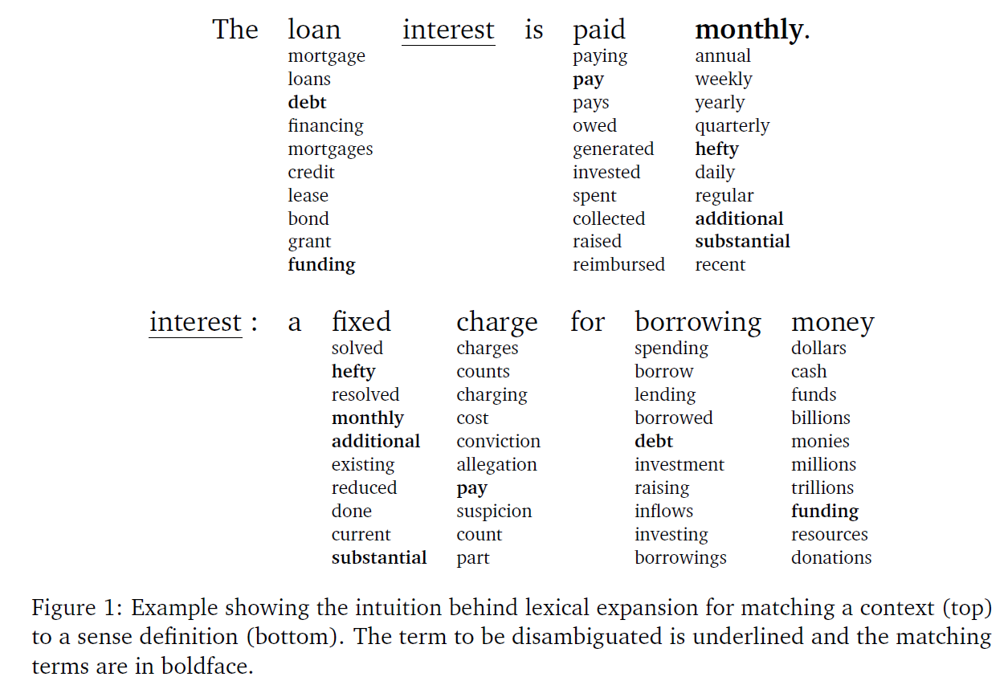

Slide 13
WSD for pun disambiguation
Above techniques fail to make sense annotations when two senses are tied for highest lexical overlap in the first or second places.
Need tie breaking strategies

Slide 14
Tie breaking strategies
POS strategy - Uses a separate POS tagger to find the POS of the pun word. Use the POS information to break a tie
Clustering strategy - Cluster the senses, and choose the sense from a cluster which is different from the already chosen one

Slide 15
POS strategy
Atleast one of the POS of the pun word is grammatical in the context, so the right pun word would be the one having the correct POS.
Preferentially selects the best sense or pair of senses whose POS matches the one applied to the target by the POS tagger

Slide 16
Cluster strategy
Pun is based on semantic incongruity - two meaning must differ significantly
Between two senses competing for the second position, it prefers the sense which are not present in the same semantic cluster and at least 3 edges distant from the first sense.

Slide 17
Baseline methods
Random - Randomly assign two senses from the sense inventory of the word.
MFS - Most frequent senses - The two most frequently used senses for that word using a sense annotated corpus.

Slide 18
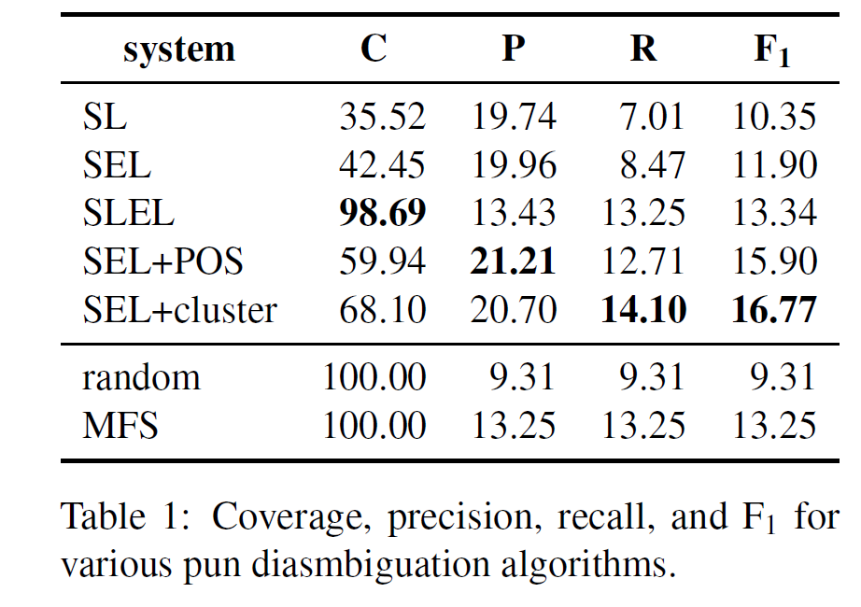

Slide 19
Comments
Using POS strategy increased coverage by 41% and gave highest precision of 21.21%.
Using cluster strategy increased coverage by 60% and resulted in the best recall 14.10% and best F1 of 16.77%.

Slide 20

Task 7 - SemEval 2017

Slide 21
2 categories, 3 subtasks
Categories - Homographic, Heterographic
Subtask 1 - Pun detection
Subtask 2 - Pun location
Subtask 3 - Pun interpretation

Slide 22
Subtask 1 - Pun detection
Given a line of text, predict if the text has a pun or not.
Used a traditional classification approach using Neural Nets. Annotated 30% of the dataset manually for supervised learning.
Features - word vectors

Slide 23
Subtask 2 - Pun location
Given a pun context find the pun word.
Process the input text to remove stop and non content words.
Eliminate those words which do not have more than 1 sense listed in wordnet.
If there is only 1 word left, return that word as pun.

Slide 24
Subtask 2 - Pun location
Find the pair of words which has the maximum similarity using their expanded synsets.
Return the word from the pair which appears later in the pun. [ Most pun words appear at the end]

Slide 25
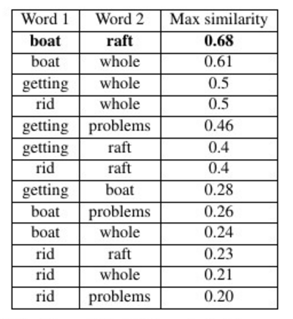
Example
Getting rid of your boat
for another could cause
a whole raft of problems
Raft appears later in the
Context which is the pun.

Slide 26
Subtask 3 - Pun interpretation
From the subtask 2, we also know for which pair of the synsets the similarity is maximum, return those senses.
Extension of subtask 2.

Slide 27
Results
Task | Precision | Recall | F1
Task 1 | 0.8918 | 0.6876 | 0.7765
Task 2 | 0.5215 | 0.5215 | 0.5215

Slide 28
Conclusion
Interpretation of pun - Difficult yet challenging
Dataset is available for further experimentation
Vector representations and deep learning can be explored for these tasks.

Slide 29
Questions ?
Email: vijaya.saradhi@research.iiit.ac.in
Twitter : @saradhix

